Slide 1
Book1
File created on: 2/27/22 12:45:02 AM GMT+05:30

Slide 2
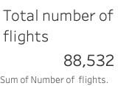

Slide 3
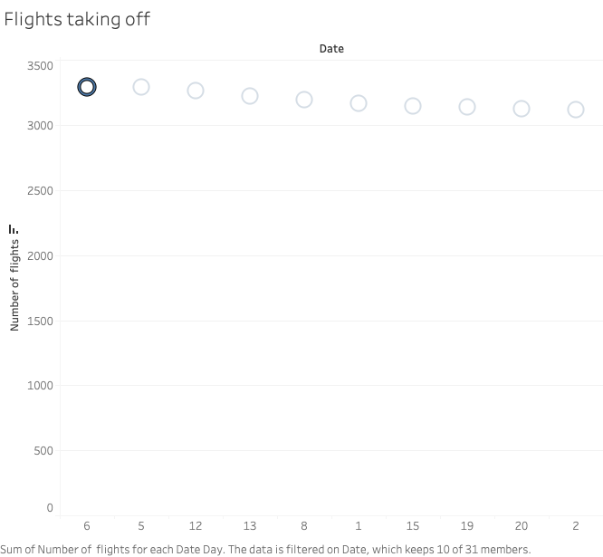

Slide 4
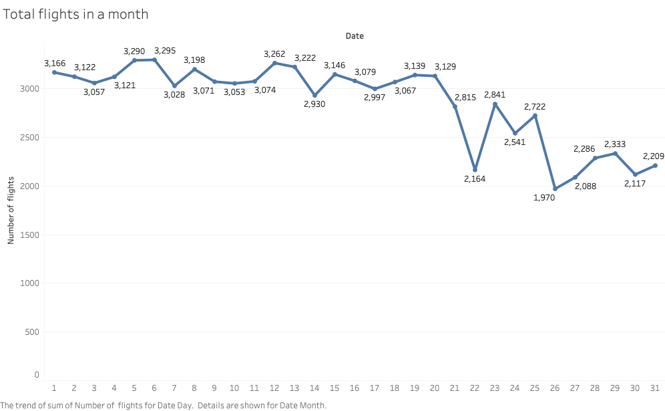

Slide 5


Slide 6


Slide 7
